Slide 1
Chapter 5:
XML and JSON Databases
XML (Extensible Markup Language)
  Processing XML Documents
  Storage of XML Documents
  Differences between XML and Relational Data
  Mappings Between XML Documents and (Object-) Relational Data
  Searching XML Data
JSON (JavaScript Object Notation)
  Similar subtopics as for XML

Slide 2
Extensible Markup Language
Basic Concepts
Document Type Definitions and XML Schema Definitions
Extensible Stylesheet Language
Namespaces
XPath

Slide 3
Basic Concepts of XML
Introduced by the World Wide Web Consortium (W3C) in 1997
Aimed at storing and exchanging complex, structured and semi-structured documents
Users can define new tags in XML (↔ HTML)

Slide 4
Basic Concepts of XML
Combination of a start tag, content and end tag is called an XML element
XML is case-sensitive
Example
<author>
<name>
<first name>Bart</first name>
<last name>Baesens</last name>
</name>
</author>

Slide 5
Basic Concepts of XML
Start tags can contain attribute values
<author email="Bart.Baesens@kuleuven.be">Bart Baesens</author>
<author>
<name>Bart Baesens</name>
<email use="work">Bart.Baesens@kuleuven.be</email>
<email use="private">Bart.Baesens@gmail.com</email>
</author>
Comments are defined as follows
<!--This is a comment line -->
Processing instructions are defined as follows
<?xml version="1.0" encoding="UTF-8"?>

Slide 6
Basic Concepts of XML
Self-defined XML tags can be used to describe document structure (↔ HTML)
  can be processed in much more detail
XML formatting rules
  only one-root element
  start tag should be closed with a matching end tag
  no overlapping tag sequence or incorrect nesting

Slide 7
Basic Concepts of XML
<?xml version="1.0" encoding="UTF-8"?>
<winecellar>
<wine>
<name>Jacques Selosse Brut Initial</name>
<year>2012</year>
<type>Champagne</type>
<grape percentage="100">Chardonnay</grape>
<price currency="EURO">150</price>
<geo>
<country>France</country>
<region>Champagne</region>
</geo>
<quantity>12</quantity>
</wine>
<wine>
<name>Meneghetti White</name>
<year>2010</year>
<type>white wine</type>
<grape percentage="80">Chardonnay</grape>
<grape percentage="20">Pinot Blanc</grape>
<price currency="EURO">18</price>
<geo>
<country>Croatia</country>
<region>Istria</region>
</geo>
<quantity>20</quantity>
</wine>
</winecellar>

Slide 8
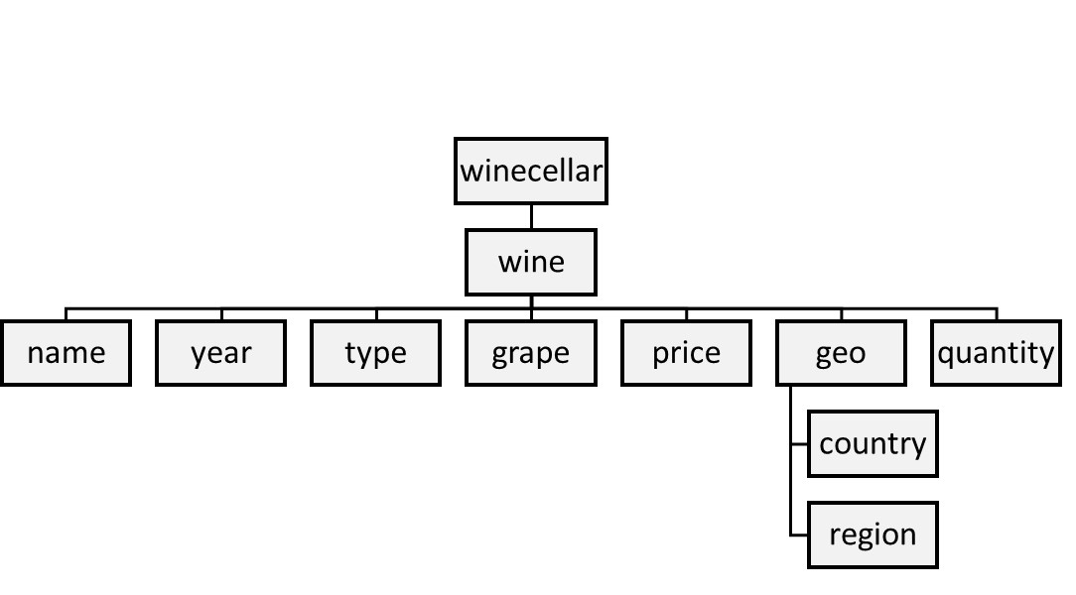
Basic Concepts of XML

Slide 9
Document Type Definitions and XML Schema Definitions
Document Type Definitions (DTD) and XML Schema Definitions (XSD) specify structure of XML document
Both define tag set, location of each tag, and nesting
XML document which complies with DTD or XSD is referred to as valid
XML document which complies with syntax is referred to as well-formed

Slide 10
Document Type Definitions and XML Schema Definitions
DTD definition for winecellar
<?xml version="1.0" encoding="UTF-8"?>
<!DOCTYPE winecellar [
<!ELEMENT winecellar (wine+)>
<!ELEMENT wine (name, year, type, grape*, price, geo, quantity)>
<!ELEMENT name (#PCDATA)>
<!ELEMENT year (#PCDATA)>
<!ELEMENT type (#PCDATA)>
<!ELEMENT grape (#PCDATA)>
<!ATTLIST grape percentage CDATA #IMPLIED>
<!ELEMENT price (#PCDATA)>
<!ATTLIST price currency CDATA #REQUIRED>
<!ELEMENT geo (country, region)>
<!ELEMENT country (#PCDATA)>
<!ELEMENT region (#PCDATA)>
<!ELEMENT quantity (#PCDATA)>
]>

Slide 11
Document Type Definitions and XML Schema Definitions
Disadvantages of DTD
  only supports character data (no support for integers, dates, complex types)
  not defined using XML syntax
XML Schema supports various data types and user-defined types

Slide 12
Document Type Definitions and XML Schema Definitions
XML Schema definition for winecellar
<?xml version="1.0" encoding="UTF-8" ?>
<xs:schema xmlns:xs="http://www.w3.org/2001/XMLSchema">
<xs:element name="winecellar">
<xs:complexType>
<xs:sequence>
<xs:element name="wine" maxOccurs="unbounded" minOccurs="0">
<xs:complexType>
<xs:sequence>
<xs:element type="xs:string" name="name"/>
<xs:element type="xs:short" name="year"/>
<xs:element type="xs:string" name="type"/>
<xs:element name="grape" maxOccurs="unbounded" minOccurs="1">
<xs:complexType>
<xs:simpleContent>
<xs:extension base="xs:string">
<xs:attribute type="xs:byte" name="percentage" use="optional"/>
</xs:extension>
</xs:simpleContent>

Slide 13
Document Type Definitions and XML Schema Definitions
XML Schema definition for winecellar (contd.)
</xs:complexType>
</xs:element>
<xs:element name="price">
<xs:complexType>
<xs:simpleContent>
<xs:extension base="xs:short">
<xs:attribute type="xs:string" name="currency" use="optional"/>
</xs:extension>
</xs:simpleContent>
</xs:complexType>
</xs:element>
<xs:element name="geo">
<xs:complexType>
<xs:sequence>
<xs:element type="xs:string" name="country"/>
<xs:element type="xs:string" name="region"/>
</xs:sequence>

Slide 14
Document Type Definitions and XML Schema Definitions
XML Schema definition for winecellar (contd.)
</xs:complexType>
</xs:element>
<xs:element type="xs:byte" name="quantity"/>
</xs:sequence>
</xs:complexType>
</xs:element>
</xs:sequence>
</xs:complexType>
</xs:element>
</xs:schema>

Slide 15
Extensible Stylesheet Language
Extensible Stylesheet Language (XSL) can be used to define stylesheet specifying how XML documents can be visualized in a web browser
XSL encompasses 2 specifications
  XSL Transformations (XSLT): transforms XML documents to other XML documents, HTML web pages, or plain text
  XSL Formatting Objects (XSL-FO): specify formatting semantics (e.g., transform XML documents to PDFs) but discontinued in 2012
Decoupling of information content from information visualization

Slide 16
Extensible Stylesheet Language
XSLT stylesheet for summary document with only name and quantity of each wine
<?xml version="1.0" encoding="UTF-8"?>
<xsl:stylesheet version="1.0" xmlns:xsl="http://www.w3.org/1999/XSL/Transform">
<xsl:template match='/'>
<winecellarsummary>
<xsl:for-each select='winecellar/wine'>
<wine>
<name><xsl:value-of select='name'/></name>
<quantity><xsl:value-of select='quantity'/></quantity>
</wine>
</xsl:for-each>
</winecellarsummary>
</xsl:template>
</xsl:stylesheet>

Slide 17
Extensible Stylesheet Language
<?xml version="1.0" encoding="UTF-8"?>
<winecellarsummary>
<wine>
<name>Jacques Selosse Brut Initial</name>
<quantity>12</quantity>
</wine>
<wine>
<name>Meneghetti White</name>
<quantity>20</quantity>
</wine>
</winecellarsummary>

Slide 18
Extensible Stylesheet Language
XSLT stylesheet for transforming XML document to HTML
<?xml version="1.0" encoding="UTF-8"?>
<html xsl:version="1.0" xmlns:xsl="http://www.w3.org/1999/XSL/Transform">
<body style="font-family:Arial;font-size:12pt;background-color:#ffff">
<h1>My Wine Cellar</h1>
<table border="1">
<tr bgcolor="#f2f2f2">
<th>Wine</th>
<th>Year</th>

Slide 19
Extensible Stylesheet Language
XSLT stylesheet for transforming XML document to HTML (contd.)
<th>Quantity</th>
</tr>
<xsl:for-each select="winecellar/wine">
<tr>
<td><xsl:value-of select="name"/></td>
<td><xsl:value-of select="year"/></td>
<td><xsl:value-of select="quantity"/></td>
</tr>
</xsl:for-each>
</table>
</body>
</html>

Slide 20
Extensible Stylesheet Language
<html>
<body style="font-family:Arial;font-size:12pt;background-color:#ffff">
<h1>My Wine Cellar</h1>
<table border="1">
<tr bgcolor="#f2f2f2">
<th>Wine</th>
<th>Year</th>
<th>Quantity</th>
</tr>
<tr>
<td>Jacques Selosse Brut Initial</td>
<td>2012</td>
<td>12</td>
</tr>
<tr>
<td>Meneghetti White</td>
<td>2010</td>
<td>20</td>
</tr>
</table> </body></html>

Slide 21
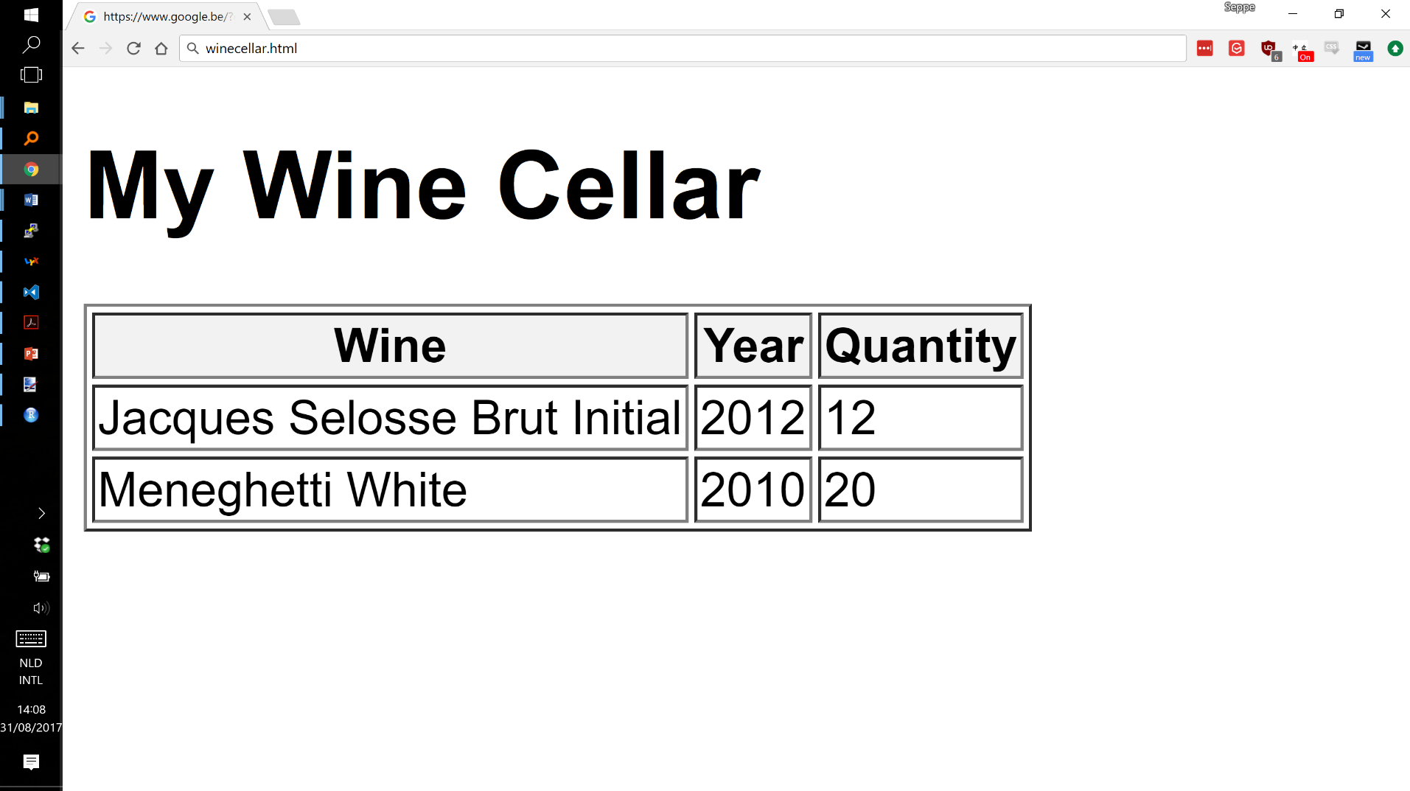
Extensible Stylesheet Language

Slide 22
Namespaces
To avoid name conflicts, XML introduced concept of a namespace
Introduce prefixes to XML elements to unambiguously identify their meaning
Prefixes typically refer to a URI (uniform resource identifier) which uniquely identifies a web resource such as a URL (uniform resource locator)
  does not need to refer to physically existing webpage

Slide 23
Namespaces
<winecellar xmlns:Bartns="www.dataminingapps.com/home.html">
<bartns:wine>
<bartns:name>Jacques Selosse Brut Initial</bartns:name>
<bartns:year>2012</bartns:year>
</bartns:wine>
<winecellar xmlns="www.dataminingapps.com/defaultns.html">

Slide 24
XPath
XPath is a simple, declarative language that uses path expressions to refer to parts of an XML document
  considers an XML document as an ordered tree
Example XPath expressions
doc("winecellar.xml")/winecellar/wine
doc("winecellar.xml")/winecellar/wine[2]
doc("winecellar.xml")/winecellar/wine[price > 20]/name

Slide 25
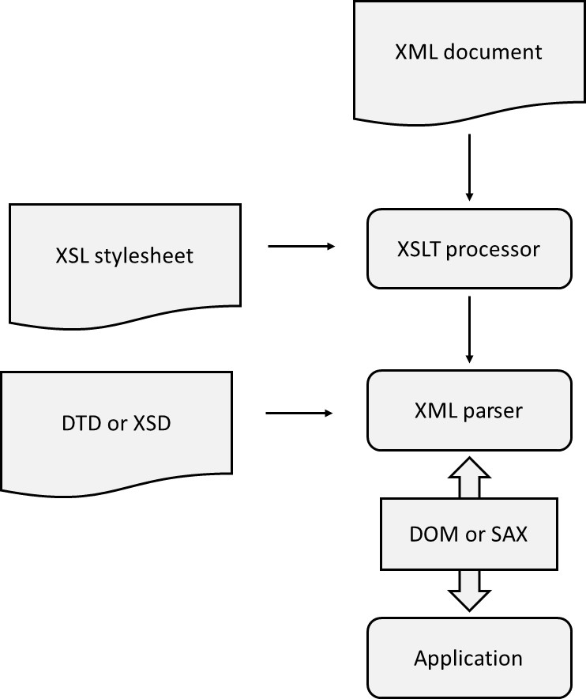
Processing XML Documents

Slide 26
Processing XML Documents
DOM API is a tree-based API and represents XML document as a tree in internal memory
  developed by W3C
DOM provides classes with methods to navigate through the tree and do various operations
DOM is useful to facilitate direct access to specific XML document parts and when a high number of data manipulations are needed, but can get memory intensive

Slide 27
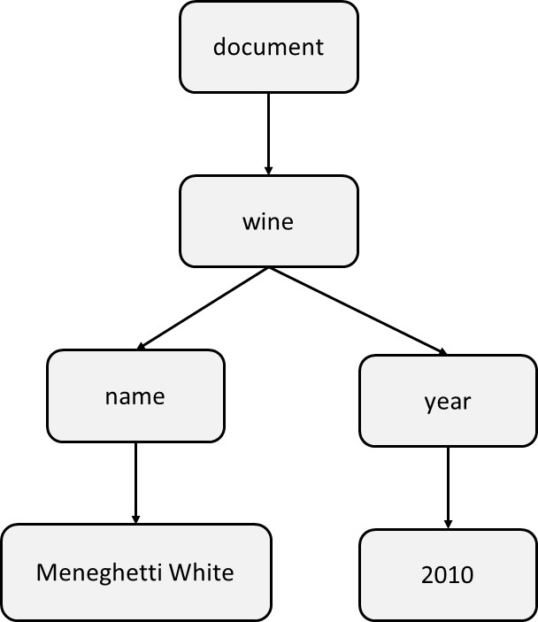
Processing XML Documents
<wine>
<name>Meneghetti White<name>
<year>2010<year>
<wine>

Slide 28
Processing XML Documents
SAX API (Simple API for XML) is an event-based API
start document
start element: wine
start element: name
text: Meneghetti
end element: name
start element: year
text: 2010
end element: year
end element: wine
end document

Slide 29
Processing XML Documents
Event stream can be passed on to application which will use an event handler
SAX has smaller memory footprint and is more scalable than DOM
SAX is excellent for sequential access, but less suited to support direct random access
SAX is less performing for heavy data manipulation than DOM
StAX (Streaming API for XML) is a compromise
  StAX allows the application to pull XML data using a cursor mechanism

Slide 30
Storage of XML Documents
XML documents stored as semi-structured data
Approaches
  document-oriented approach
  data-oriented approach
  combined approach

Slide 31
Document-Oriented Approach for Storing XML Documents
XML document will be stored as a BLOB or CLOB in a table cell
  RDBMS considers these as ‘black box’ data
  querying based upon full-text search
  (O)RDBMSs have introduced XML data type (SQL/XML extension)
Simple approach
  no need for DTD or XSD for the XML document
  especially well-suited for storing static content
  but: poor integration with relational SQL query processing

Slide 32
Data-Oriented Approach for Storing XML Documents
XML document decomposed into data parts spread across a set of connected (object-) relational tables (shredding)
For highly structured documents and fine-granular queries
DBMS or middleware can do translation
Schema-oblivious shredding (starts from XML document) versus schema-aware shredding (starts from DTD/ XSD)
Advantages
  SQL queries can now directly access individual XML elements
  reconstruct XML document using SQL joins
Object-relational DBMS as an alternative

Slide 33
Combined Approach for Storing XML Documents
Combined approach (partial shredding) combines document- and data-oriented approach
Some parts stored as BLOBs, CLOBs, or XML objects, whereas other parts shredded
SQL views are defined to reconstruct XML document
Most DBMSs provide facilities to determine optimal level of decomposition
Mapping approaches can be implemented using middleware or by DBMS (XML-enabled DBMS)

Slide 34
Differences Between XML Data and Relational Data
Building block of relational model is mathematical relation which consists of 0, 1 or more unordered tuples
Each tuple consists of 1 or more attributes
The relational model does not implement any type of ordering (↔ XML model)
  add extra attribute type in RDBMS
  use list collection type in object-relational DBMS

Slide 35
Differences Between XML Data and Relational Data
Relational model does not support nested relations (first normal form)
  ↔ XML data is hierarchically structured
  object-relational DBMS supports nested relations
Relational model does not support multivalued attribute types (first normal form)
  ↔ XML allows same child element to appear multiple times
  additional table needed in relational model
  object-relational model supports collection types

Slide 36
Differences Between XML Data and Relational Data
RDBMS only supports atomic data types, such as integer, string, date, etc.
  XML DTDs don’t support atomic data types (only (P)CDATA)
  XML Schema supports both atomic and aggregated types
  aggregated types modeled in object-relational databases using user defined types
XML data is semi-structured
  can include certain anomalies
  change to DTD or XSD necessitates re-generation of tables

Slide 37
Mappings Between XML Documents and (Object-) Relational Data
Table-Based Mapping
Schema-Oblivious Mapping
Schema-Aware Mapping
SQL/XML

Slide 38
Table-Based Mapping
Specifies strict requirements to the structure of the XML document
<database>
<table>
<row>
<column1> data </column1>
…
</row>
<row>
<column1> data </column1>
…
</row>
…
</table>
<table>
…
</table>
…
</database>

Slide 39
Table-Based Mapping
Actual data is stored as content of column elements
Advantage is simplicity given the perfect one-to-one mapping
Document structure can be implemented using an updatable SQL view
Disadvantage is rigid structure of XML document
  can be mitigated by XSLT

Slide 40
Schema-Oblivious Mapping
Schema-oblivious mapping (shredding) transforms XML document without availability of DTD or XSD
First option is to transform the document to a tree structure, whereby the nodes represent the data in the document
  tree can then be mapped to a relational model
Example table
CREATE TABLE NODE(
ID CHAR(6) NOT NULL PRIMARY KEY,
PARENT_ID CHAR(6),
TYPE VARCHAR(9),
LABEL VARCHAR(20),
VALUE CLOB,
FOREIGN KEY (PARENT_ID) REFERENCES NODE (ID)
CONSTRAINT CC1 CHECK(TYPE IN ("element", "attribute")));

Slide 41
Schema-Oblivious Mapping
ID | PARENT_ID | TYPE | LABEL | VALUE
1 | NULL | element | winecellar | NULL
2 | 1 | element | wine | NULL
3 | 2 | attribute | winekey | 1
4 | 2 | element | name | Jacques Selosse Brut Initial
5 | 2 | element | year | 2012
6 | 2 | element | type | Champagne
7 | 2 | element | price | 150
8 | 1 | element | wine | NULL
9 | 8 | attribute | winekey | 2
10 | 8 | element | name | Meneghetti White
11 | 8 | element | year | 2010
12 | 8 | element | type | white wine
13 | 8 | element | price | 18
<?xml version="1.0" encoding="UTF-8"?>
<winecellar>
<wine winekey="1">
<name>Jacques Selosse Brut Initial</name>
<year>2012</year>
<type>Champagne</type>
<price>150</price>
</wine>
<wine winekey="2">
<name>Meneghetti White</name>
<year>2010</year>
<type>white wine</type>
<price>18</price>
</wine>
</winecellar>

Slide 42
Schema-Oblivious Mapping
XPath or XQuery (see later) queries can be translated into SQL of which the result can be translated back to XML
Example
doc("winecellar.xml")/winecellar/wine[price > 20]/name
SELECT N2.VALUE
FROM NODE N1, NODE N2
WHERE
N2.LABEL="name" AND
N1.LABEL="price" AND
CAST(N1.VALUE AS INT)> 20 AND
N1.PARENT_ID=N2.PARENT_ID

Slide 43
Schema-Oblivious Mapping
Single table requires extensive querying (e.g., self-joins)
More tables can be created
Mapping can be facilitated by making use of object-relational extensions
Due to extensive shredding, reconstruction of XML document can get quite resource intensive
  middleware solutions offer DOM API or SAX API on top of DBMS
  materialized views

Slide 44
Schema-Aware Mapping
Steps to generate database schema from DTD or XSD
  simplify DTD or XSD
  map complex element type to relational table, or user-defined type, with corresponding primary key
  map element type with mixed content to separate table where the (P)CDATA is stored; connect using primary-foreign key relationship
  map single-valued attribute types, or child elements that occur only once, with (P)CDATA content to a column in the corresponding relational table; when starting from XSD, choose the SQL data type which most closely resembles
  map multi-valued attribute types, or child elements that can occur multiple times, with (P)CDATA content to a separate table; use primary-foreign key relationship; use collection type in case of object-relational DBMS
  for each complex child element type, connect the tables using a primary-foreign key relationship

Slide 45
Schema-Aware Mapping
Generate a DTD or XSD from a database model
  map every table to an element type
  map every table column to an attribute type or child element type with (P)CDATA in case of DTD, or most closely resembling data type in case of XML Schema
  map primary-foreign key relationships by introducing additional child element types
  object-relational collections can be mapped to multivalued attribute types or element types which can occur multiple times

Slide 46
SQL/XML
Extension of SQL which introduces
  new XML data type with corresponding constructor that treats XML documents as cell values in a column of a relational table, and can be used to define attribute types in user-defined types, variables, and parameters of user-defined functions
  set of operators for the XML data type
  set of functions to map relational data to XML
No rules for shredding

Slide 47
SQL/XML
CREATE TABLE PRODUCT(
PRODNR CHAR(6) NOT NULL PRIMARY KEY,
PRODNAME VARCHAR(60) NOT NULL,
PRODTYPE VARCHAR(15),
AVAILABLE_QUANTITY INTEGER,
REVIEW XML);
INSERT INTO PRODUCT VALUES("120", "Conundrum", "white", 12,
XML(<review><author>Bart Baesens</author><date>27/02/2017</date> <description>This is an excellent white wine with intriguing aromas of green apple, tangerine and honeysuckle blossoms.<description><rating max-value="100">94</rating></review>);

Slide 48
SQL/XML
SQL/XML can be used to represent relational data in XML
  default mapping whereby names of tables and columns are translated to XML elements and row elements are included for each table row
  also adds corresponding DTD or XSD
SQL/XML also includes facilities to represent the output of SQL queries in a tailored XML format
  XMLElement defines XML element using 2 arguments: name of XML element and column name

Slide 49
SQL/XML
SELECT XMLElement("sparkling wine", PRODNAME)
FROM PRODUCT
WHERE PRODTYPE="sparkling";
<sparkling wine>Meerdael, Methode Traditionnelle Chardonnay, 2014 </sparkling wine>
<sparkling wine>Jacques Selosse, Brut Initial, 2012</sparkling wine>
<sparkling wine>Billecart-Salmon, Brut Réserve, 2014</sparkling wine>
…

Slide 50
SQL/XML
SELECT XMLElement("sparkling wine", XMLAttributes(PRODNR AS "prodid"), XMLElement("name", PRODNAME), XMLElement("quantity", AVAILABLE_QUANTITY))
FROM PRODUCT
WHERE PRODTYPE="sparkling";
<sparkling wine prodid="0178">
<name>Meerdael, Methode Traditionnelle Chardonnay, 2014</name>
<quantity>136</quantity>
</sparkling wine>
<sparkling wine prodid="0199">
<name>Jacques Selosse, Brut Initial, 2012</name>
<quantity>96</quantity>
</sparkling wine>
…
SELECT XMLElement("sparkling wine", XMLAttributes(PRODNR AS "prodid"), XMLForest(PRODNAME AS "name", AVAILABLE_QUANTITY AS "quantity"))
FROM PRODUCT
WHERE PRODTYPE="sparkling";

Slide 51
Searching XML Data
Full-text search
Keyword-Based Search
Structured Search with Xquery
(Semantic Search with RDF and SPARQL)

Slide 52
Full-text search
Treat XML documents as textual data and conduct brute force full-text search
Does not take into account any tag structure
Can be applied to XML documents that have been stored as files or as BLOB/CLOB objects
Usually by means of object-relational extension
No semantically-rich queries targeting individual XML elements

Slide 53
Keyword-Based Search
Assumes XML document is complemented with a set of keywords describing document metadata
Keywords can be indexed by text search engines
Document still stored in a file or as BLOB/CLOB
Still not full expressive power of XML for querying

Slide 54
Structured Search with XQuery
Structured search uses structural metadata which relates to actual document content
E.g., XML book reviews
  document metadata: properties of the document such as, author of the review document (e.g., Wilfried Lemahieu) and creation date (e.g., June 6th, 2017)
  structural metadata: role of individual content fragments within the overall document structure, e.g., title of book ( ‘Analytics in a Big Data World’), author of book (‘Bart Baesens’), …

Slide 55
Structured Search with XQuery
Structured search queries query document content by means of structural metadata
  E.g., search for reviews of books authored by Bart Baesens
XQuery formulates structured queries for XML documents
  can consider both document structure and elements’ content
  XPath path expressions are used for navigation
  includes constructs to refer to and compare content of elements
  syntax similar to SQL

Slide 56
Structured Search with XQuery
XQuery statement is formulated as a FLOWR instruction
FOR $variable IN expression
LET $variable:=expression
WHERE filtercriterion
ORDER BY sortcriterion
RETURN expression

Slide 57
Structured Search with XQuery
LET $maxyear:=2012
RETURN doc("winecellar.xml")/winecellar/wine[year <$maxyear]
FOR $wine IN doc("winecellar.xml")/winecellar/wine
ORDER BY $wine/year ASCENDING
RETURN $wine
FOR $wine IN doc("winecellar.xml")/winecellar/wine
WHERE $wine/price < 20 AND $wine/price/@currency="EURO"
RETURN <cheap wine> {$wine/name, $wine/price}</cheap wine>
FOR $wine IN doc("winecellar.xml")/wine
$winereview IN doc("winereview.xml")/winereview
WHERE $winereview/@winekey=$wine/@winekey
RETURN <wineinfo> {$wine, $winereview/rating} </wineinfo>

Slide 58
JSON (JavaScript Object Notation)
Originated from the JavaScript programming language, but now language-independent and widely used for data exchange in web applications, APIs, and databases
Like XML, JSON is designed to represent (semi-)structured data in a format that is both human-readable and machine-processable
Generally more compact and less verbose than XML
Common principles with XML: hierarchy, nesting, and document validity

Slide 59
Basic Concepts of JSON
JSON represents data using key–value pairs. For example:
{ "author": "Bart Baesens" }
A key (“author”) labels a value (“Bart Baesens”), similar to the way an XML tag gives meaning to content in XML:
<author>Bart Baesens</author>
Case-sensitive, similar to XML
Data structures are built using two fundamental constructs :
  Objects, defined by curly braces { }, containing unordered key–value pairs
  Arrays, defined by square brackets [ ], containing ordered lists of values

Slide 60
Basic Concepts of JSON
JSON objects can be nested to represent hierarchical data
A JSON document can therefore be represented as a tree, just like an XML document
Nested objects define parent–child relationships
    "geo": {
    "country": "France",
    "region": "Champagne"
    }

Slide 61
Basic Concepts of JSON
Arrays are used to represent multiple occurrences of the same kind of information
Corresponds to repeated elements in XML
Arrays are ordered
Array values can themselves be objects, allowing repeated complex structures
"grape": [
{ "percentage": 80, "variety": "Chardonnay" },
{ "percentage": 20, "variety": "Pinot Blanc" }
]

Slide 62
Basic Concepts of JSON
XML distinguishes between elements and attributes
JSON has no separate notion of attributes
All data is represented uniformly as key–value pairs
Metadata can be represented as an additional field or nested object
"price": {
"currency": "EURO",
"amount": 150
}

Slide 63
JSON: example
{
"winecellar": {
"wine": [
{
"name": "Jacques Selosse Brut Initial",
"year": "2012",
"type": "Champagne",
"grape": {
"percentage": "100",
"text": "Chardonnay"
},
"price": {
"currency": "EURO",
"text": "150"
},

Slide 64
JSON: example
{
"percentage": "20",
"text": "Pinot Blanc"
}
],
"price": {
"currency": "EURO",
"text": "18"
},
"geo": {
"country": "Croatia",
"region": "Istria"
},
"quantity": "20"
}
]
}
}
"geo": {
"country": "France",
"region": "Champagne"
},
"quantity": "12"
},
{
"name": "Meneghetti White",
"year": "2010",
"type": "white wine",
"grape": [
{
"percentage": "80",
"text": "Chardonnay"
},

Slide 65
Syntactically Correct JSON
A JSON document must satisfy strict syntax rules before it can be processed
Objects and arrays must be properly opened and closed
Keys are strings and key–value pairs must be separated correctly
Braces and brackets must be properly balanced
A JSON parser rejects documents that violate these rules

Slide 66
JSON Schema
JSON Schema serves essentially the same purpose as XSD for XML
Supports atomic data types such as string, number, integer and Boolean
Structural constraints are expressed in terms of objects and arrays
Can specify required and optional fields
Can constrain the structure and cardinality of arrays
A syntactically correct JSON document is not necessarily valid against its schema

Slide 67
JSON Schema example
{
"$schema": "https://json-schema.org/draft/2020-12/schema",
"type": "object",
"properties": {
"winecellar": {
"type": "object",
"properties": {
"wine": {
"type": "array",
"items": {
"type": "object",
"properties": {
"name": { "type": "string" },
"year": { "type": "integer" },
"type": { "type": "string" },
"grape": {
"type": "array",
"items": {
"type": "object",
"properties": {
"variety": { "type": "string" },
"percentage": { "type": "integer" }
},
"required": ["variety"]
}
},
…

Slide 68
Navigating JSON Documents
Hierarchical JSON data can be navigated using path expressions
JSONPath is commonly used to select values based on their location in the document tree
SQL/JSON also defines path expressions for accessing JSON stored in a DBMS
The principle is similar to XPath navigation in XML
Exact syntax depends on the tool or database system
$.winecellar.wine[*].name

Slide 69
XML concepts not present in JSON
No standard transformation language → use application code or dedicated tools
No namespaces → use proper naming conventions (prefixes) and nesting

Slide 70
Processing JSON Documents
JSON processing follows similar pipeline as XML processing
JSON document is parsed and checked for syntactic correctness
It can optionally be validated against a JSON Schema
The parsed data can then be accessed and processed by an application
Most JSON libraries can represent a document as an in-memory tree of objects and arrays
Streaming parsers process JSON incrementally instead of loading the complete document into memory

Slide 71
Processing JSON Documents
In-memory tree of objects and arrays
  Facilitates direct access to specific parts of the document
  Convenient when many data manipulations are required
  Can become memory intensive for very large documents
  Conceptually similar to DOM processing for XML
Streaming parsers
  Smaller memory footprint and good scalability
  Well suited for large documents and continuous data streams
  Sequential access is easier than direct random access
  Conceptually similar to SAX/StAX processing for XML

Slide 72
Storage of JSON Documents
JSON documents can be stored using the same general approaches as XML documents:
  Document-oriented approach: store the complete document
  Data-oriented approach: decompose the document into relational data (shredding)
  Combined approach: keep some parts as JSON and shred other parts
Choice depends on the required flexibility and granularity of access
Document store DBMSs (see also next chapter) are designed to store and query JSON documents natively

Slide 73
Mappings Between
JSON and Relational Data
The mapping strategies introduced for XML also apply to JSON
Table-based mapping closely mirrors the relational structure
Schema-oblivious mapping derives a generic representation directly from the document
Schema-aware mapping uses known structural constraints to design the relational schema
JSON changes the representation, not the fundamental mapping problem

Slide 74
SQL/JSON
SQL/JSON extends SQL with standardized support for JSON data in RDBMSs
It plays a role analogous to SQL/XML for XML data
SQL/JSON supports storing, querying and generating JSON data
SQL/JSON path expressions can access individual parts of a JSON document
Functions can construct JSON from relational query results
JSON values can be combined with ordinary relational columns in the same query

Slide 75
Storing JSON in a Relational Table
Modern RDBMSs can store JSON documents in a column
The PRODUCT table below combines ordinary relational attributes with a JSON review
Applications can therefore retain flexible JSON structures without abandoning relational SQL
CREATE TABLE PRODUCT (
PRODNR CHAR(6) PRIMARY KEY,
PRODNAME VARCHAR(60),
AVAILABLE_QUANTITY INTEGER,
REVIEW JSON
)

Slide 76
Generating JSON: JSON_OBJECT
JSON_OBJECT constructs a JSON object from relational values
Column values become values of JSON key–value pairs
Each selected relational row can therefore be transformed into a JSON object
SELECT JSON_OBJECT(
'product' VALUE PRODNAME,
'quantity' VALUE AVAILABLE_QUANTITY)
FROM PRODUCT
→ {"product":"Meneghetti White","quantity":20}

Slide 77
Generating JSON: Arrays
SELECT JSON_ARRAY(PRODNAME, AVAILABLE_QUANTITY)
FROM PRODUCT
→ ["Jacques Selosse Brut Initial",20]
["Meneghetti White",30]
["Château Margaux",15]
SELECT JSON_ARRAYAGG(PRODNAME)
FROM PRODUCT
→ [
"Jacques Selosse Brut Initial",
"Meneghetti White",
"Château Margaux"
]
JSON_ARRAY constructs JSON arrays from a set of values
JSON_ARRAYAGG aggregates values from multiple rows into a single JSON array
These functions are useful when relational query results must be returned as JSON

Slide 78
JSON_TABLE: JSON → Relational Data
JSON_TABLE projects JSON data into relational rows and columns
JSON path expressions specify which JSON values become columns
The resulting table can be processed using ordinary SQL
This provides a direct bridge from hierarchical JSON data to the relational model
SELECT *
FROM JSON_TABLE(
REVIEW, '$'
COLUMNS(
AUTHOR VARCHAR(50) PATH '$.author',
SCORE INTEGER PATH '$.rating.score'
)
)
AUTHOR SCORE
Bart Baesens 94

Slide 79
JSON: conclusions
JSON represents hierarchical, semi-structured data using objects and arrays
JSON is less verbose than XML, but XML offers a (for now!) richer and more mature ecosystem for schema definition, validation, namespaces, transformation, and querying
Also exists: YAML (YAML Ain’t Markup Language). This is a superset of JSON with a more human-readable, even less verbose syntax, particularly popular for configuration files. However, JSON is more commonly used for data exchange and APIs

